Slide 1
CSCI 316 Group Assignment
Task 1 & 2
Group 7
Ryan Hong Yang Tan (8560341)
Sim Zhan Qi (8930831)
Au Wei Xiang (7538753)
Pek Xin Ying Janice (7579172)
Trustan Wu (7558867)

Slide 2
Dataset Introduction
Dataset: Flight Price Prediction
Clean_Dataset.csv: Contains the combined dataset of economy class data and business class data
Key Features of the Dataset:
Number of samples: 300,153
Original Number of Features: 10
Label: price - The price of the flight

Slide 3
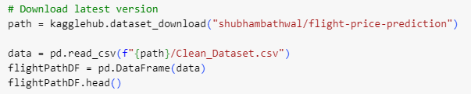
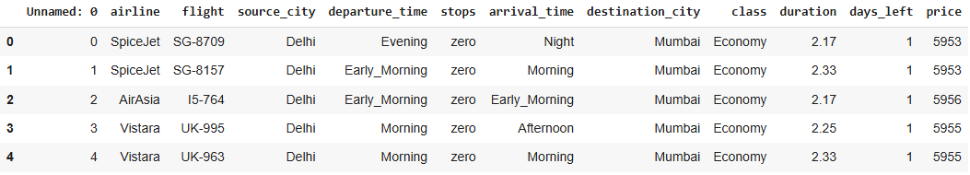
Dataset Discovery (Top 5 Rows)

Slide 4
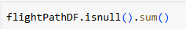
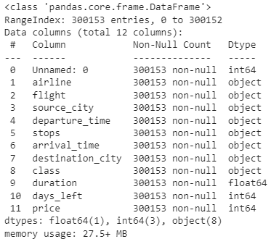
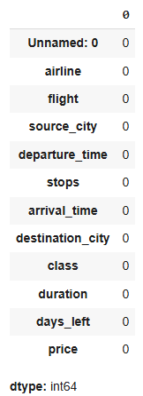
Dataframe information

Slide 5
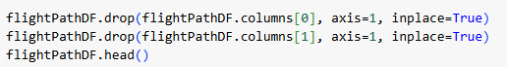
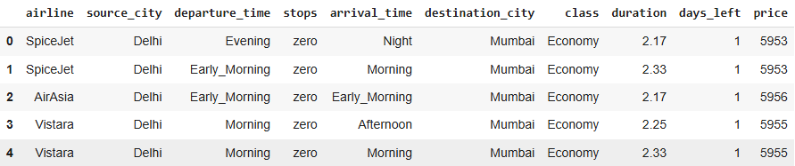
Dropping irrelevant columns
Columns dropped: “Unnamed: 0” and “flight”

Slide 6
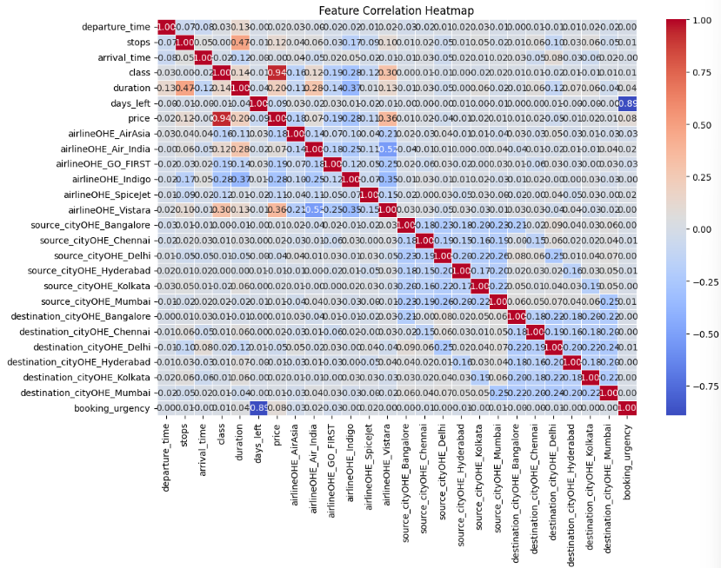
Heatmap
Highest correlation present with price:
class
airline_OHE

Slide 7
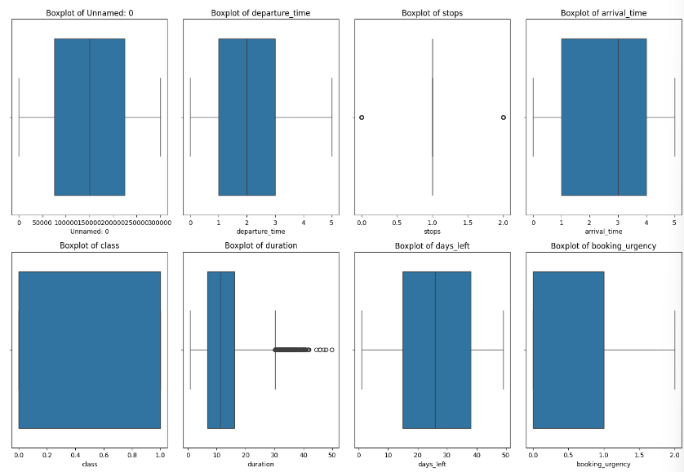
Outlier Detection

Slide 8
Outlier handling
Why we did not perform outlier handling techniques such as winsorization?
The outliers represents actual values
Removing/editing them could affect model accuracy
Tree-based models are also robust to outliers and as such they would not affect our prediction

Slide 9
Feature Selection
Why we did not cut down on number of features?
Low number of features: Removing might reduce the capacity of the model to learn useful patterns
Model Complexity: Removing might disrupt feature interaction, leading to less accurate model

Slide 10
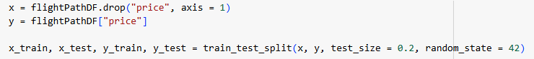
Splitting the dataset (80% training, 20% testing)
Random sampling is used, why?
Our dataset label is continuous
Using stratified sampling, forcing the data into arbitrary bins could lead to information loss and artificial division
Not reflecting the actual distribution of prices

Slide 11
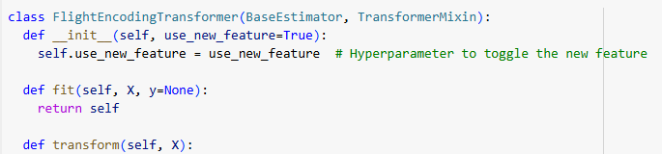
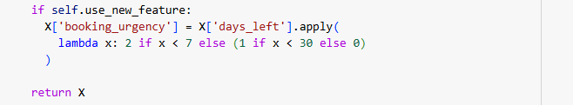
User Defined Transformer
New feature defined: “booking_urgency” which bins the “days_left” into 3 different urgency rating

Slide 12
Model Chosen
Model: | Why we chose this:
Decision Tree Model | Basic Algorithm Model which is easy to understand Decision trees are robust because they adapt to data without assuming a specific distribution. Fast predictions and easy to train.
Random Forest Regressor | Works well for feature importance analysis Able to work efficiently with these categorical encodings Captures non-linear relationships better than linear models
Gradient Boosting Regressor | Able to handle structured data well More robust to overfitting as it focuses on reducing errors Adapts well to non-linear relationships

Slide 13
Task 1

Slide 14
Decision Tree

Slide 15
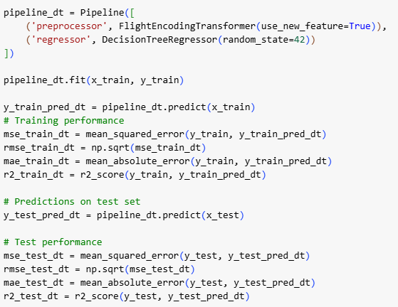
Decision Tree Model (Model Building)
Task 1: Scikit Learn
 | Train Data | Test Data
Mean Squared Error | 367483.561 | 12487866.139
Root Mean Squared Error | 606.204 | 3533.817
Mean Absolute Error | 58.314 | 1169.537
R-Squared | 0.99928 | 0.97577

Slide 16
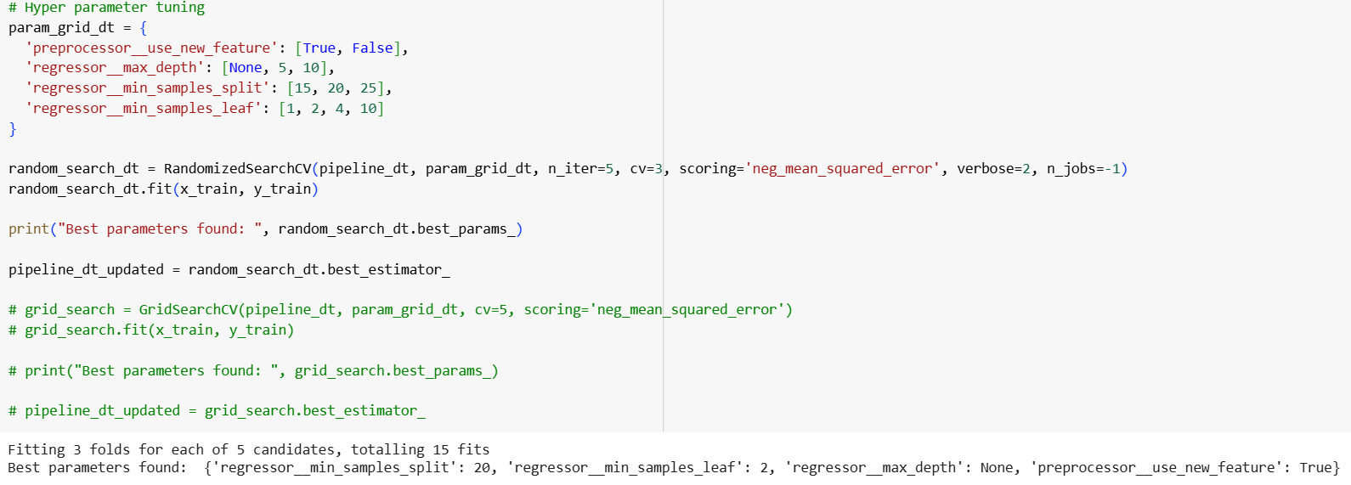
Decision Tree Model (Hyperparameter Tuning)
Hyperparameter | Best Value
preprocessor__use_new_feature | True
regressor__max_depth | None
regressor__min_samples_split | 20
regressor__min_samples_leaf | 2

Slide 17
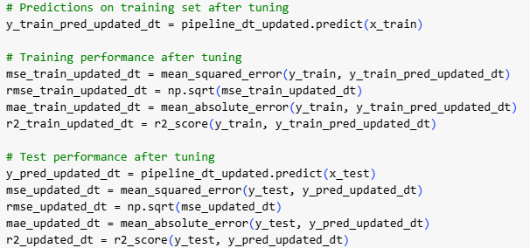
Decision Tree Model (Updated Model Based On Tuning)
Task 1: Scikit Learn
 | Train Data | Test Data
Mean Squared Error | 4972764.109 | 12487866.139
Root Mean Squared Error | 2229.969 | 3533.817
Mean Absolute Error | 903.083 | 1169.537
R-Squared | 0.99034 | 0.97577

Slide 18
Decision Tree Model (Performance comparison)
 | Before Tuning | After Tuning
Mean Squared Error | 12487866.139 | 8564914.485
Root Mean Squared Error | 3533.817 | 2926.587
Mean Absolute Error | 1169.537 | 1196.994
R-Squared | 0.97577 | 0.98338

Slide 19
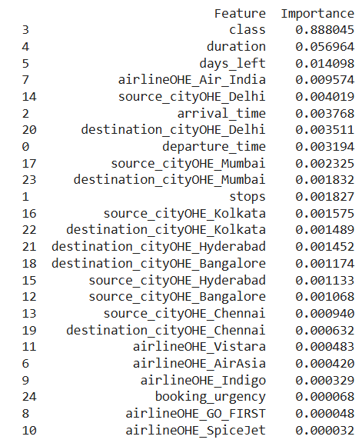
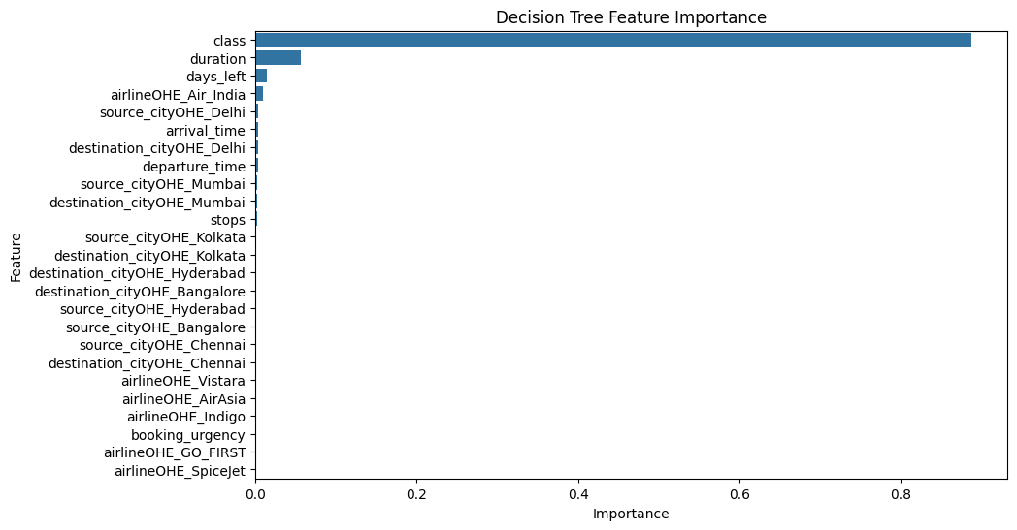
Decision Tree Model (Feature importance)

Slide 20
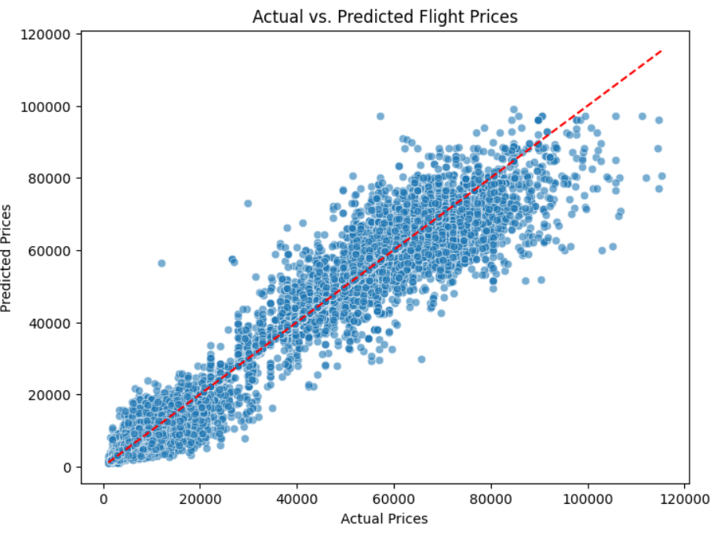
Decision Tree Model (Actual vs. Predicted)
Points generally follow the diagonal line
Shows 2 main cluster which indicates that price prediction at the price point might be more accurate

Slide 21
Random Forest

Slide 22
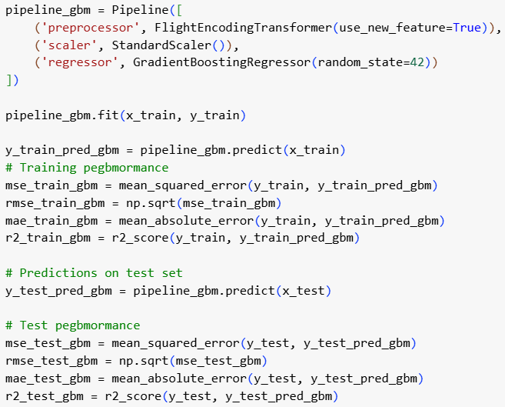
Random Forest Regressor
Task 1: Scikit Learn
 | Train Data | Test Data
Mean Squared Error | 1275249.305 | 7778260.985
Root Mean Squared Error | 1129.269 | 2788.953
Mean Absolute Error | 419.680 | 1084.110
R-Squared | 0.99752 | 0.98491

Slide 23
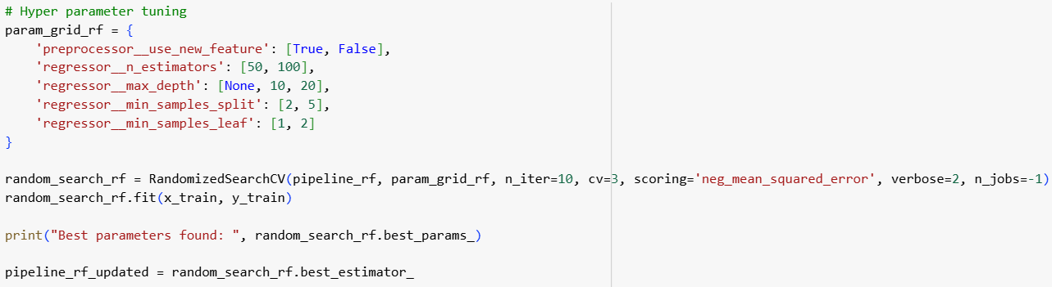
Random Forest Regressor (Fine Tuning)
Hyperparameter | Best Value
preprocessor_use_new_feature | True
regressor_n_estimators | 100
regressor__max_depth | None
regressor__min_samples_split | 2
regressor__min_samples_leaf | 2

Slide 24
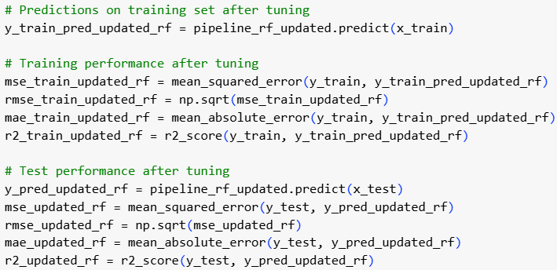
Random Forest Regressor (Fine Tuning)
 | Train Data | Test Data
Mean Squared Error | 2764799.684 | 7272233.184
Root Mean Squared Error | 1662.769 | 2696.708
Mean Absolute Error | 658.319 | 1096.053
R-Squared | 0.99463 | 0.98589

Slide 25
Random Forest Regressor (Performance Comparison)
 | Before Tuning | After Tuning
Mean Squared Error | 7778260.985 | 7272233.184
Root Mean Squared Error | 2788.953 | 2696.708
Mean Absolute Error | 1084.110 | 1096.053
R-Squared | 0.985 | 0.986

Slide 26
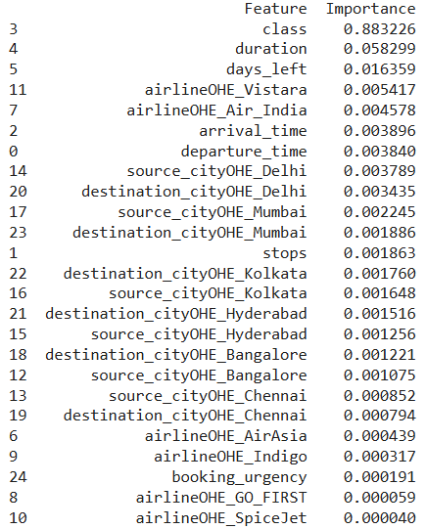
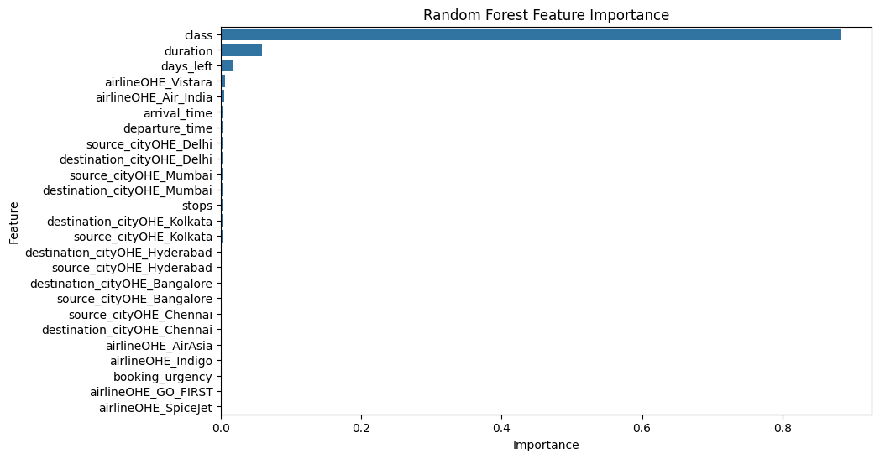
Random Forest Regressor (Feature Importance)

Slide 27
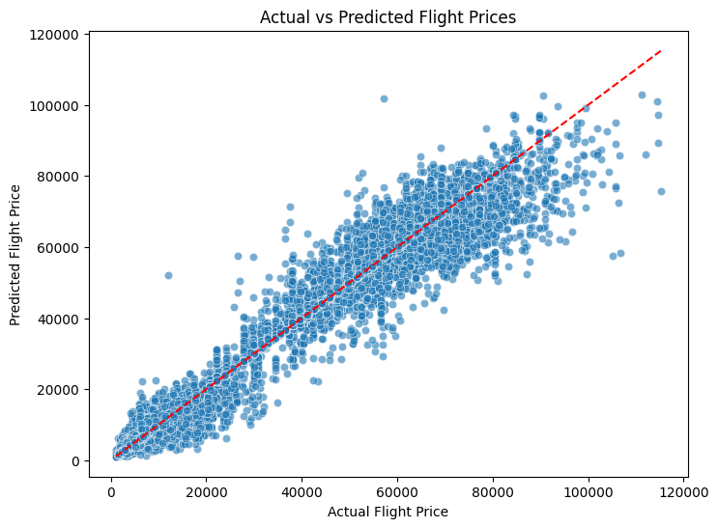
Random Forest Regressor (Actual vs. Predicted)
Captures relationship well.
A good predictive accuracy.
However, slight deviation indicates some errors of over/underfitting.
Notes:
As the actual flight price and predicted price follows an upwardly proportional trend, RF has captured the relationship well.

Slide 28
Gradient Boosting

Slide 29
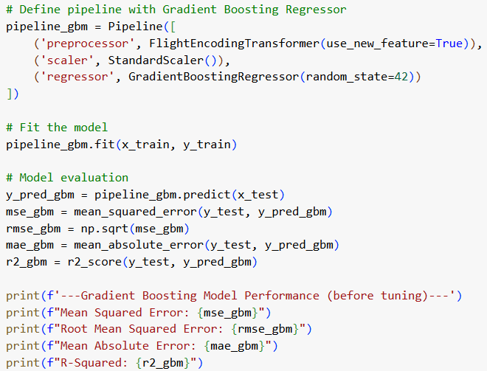
Gradient Boosting Regressor
Task 1: Scikit Learn
 | Train Data | Test Data
Mean Squared Error | 24434939.024 | 24930672.378
Root- Mean Squared Error | 4943.024 | 4993.062
Mean Absolute Error | 2934.788 | 2937.760
R-Squared | 0.953 | 0.952

Slide 30
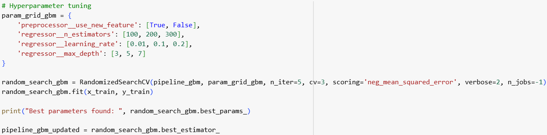
Gradient Boosting Regressor (Fine Tuning)
Hyperparameter | Best Value
preprocessor__use_new_feature | True
regressor__n_estimators | 100
Regressor__max_depth | 7
regressor_learning_rate | 0.2

Slide 31
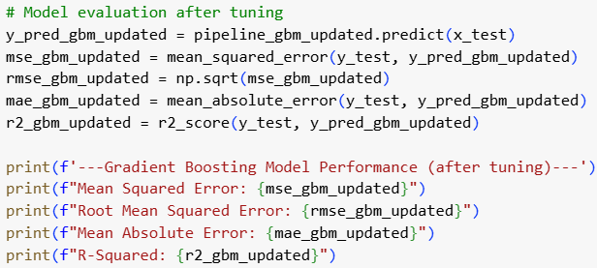
Gradient Boosting Regressor (Fine Tuning)

Slide 32
Gradient Boosting Regressor
 | Before Tuning | After Tuning
Mean Squared Error | 10063427.669 | 11136187.400
Root Mean Squared Error | 3172.291 | 3337.093
Mean Absolute Error | 1796.889 | 1870.507
R-Squared | 0.98046 | 0.97840

Slide 33

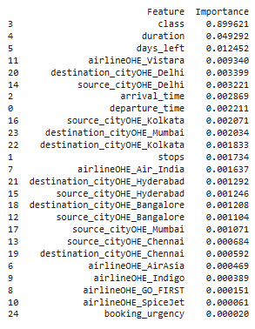
Gradient Boosting Regressor

Slide 34
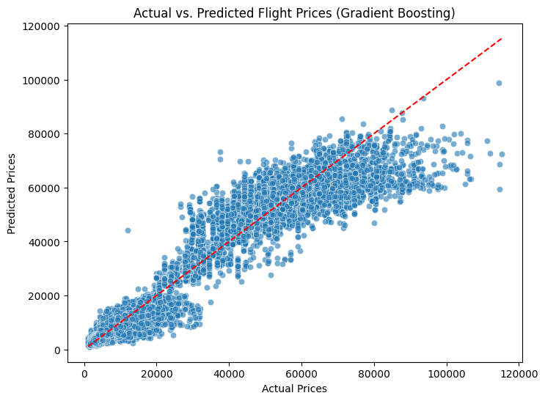
Gradient Boosting Regressor
Captures overall trends well.
A fairly predictive accuracy.
However, struggles with higher price ranges with Higher Variance

Slide 35
Model Performance
Model | MSE (Mean Squared Error) | RMSE (Root Mean Squared Error) | MAE (Mean Absolute Error) | R-Squared
Decision Tree | 8564914.485 | 2926.587 | 1196.994 | 0.98338
Random Forest | 7272233.184 | 2696.708 | 1096.053 | 0.98589
Gradient Boosted | 11136187.400 | 3337.093 | 1870.507 | 0.97840

Slide 36
Task 2

Slide 37
Decision Tree

Slide 38
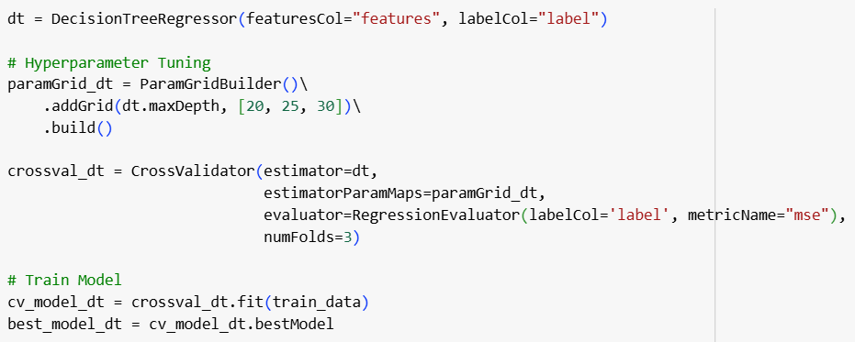
Decision Tree Model (Model Building)
Task 2: Spark MLlib

Slide 39
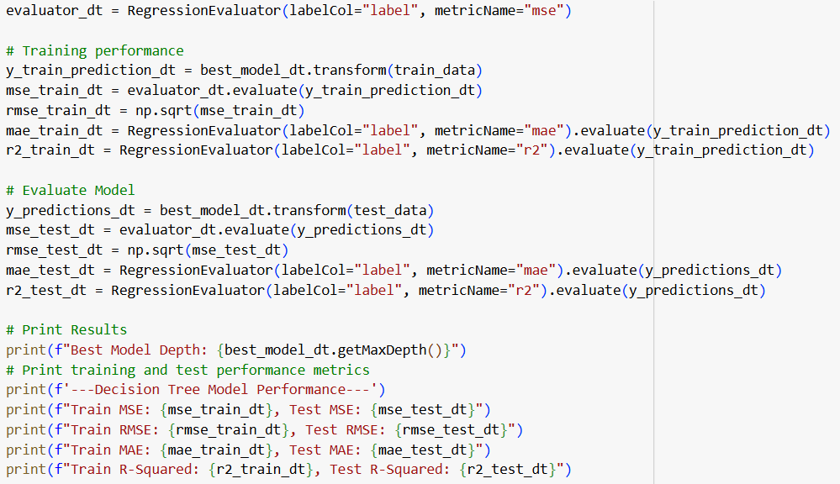
Decision Tree Model (Model Evaluation)
Best Model Depth: 30
 | Train Data | Test Data
Mean Squared Error | 15925864.637 | 17432124.374
Root Mean Squared Error | 3990.722 | 4175.179
Mean Absolute Error | 2323.786 | 2441.642
R-Squared | 0.96912 | 0.96601

Slide 40
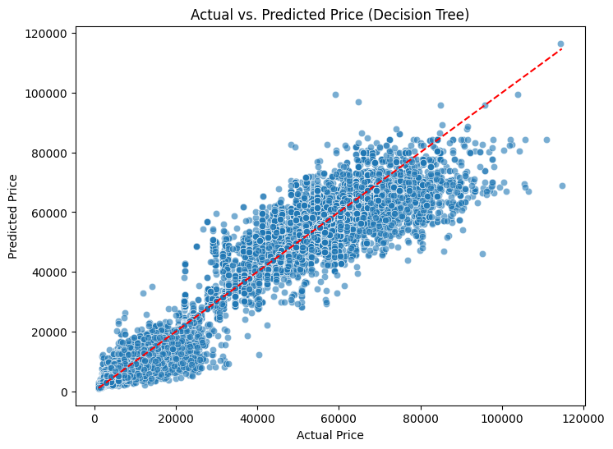
Decision Tree Model (Actual vs. Predicted)
Points generally follow the diagonal line
Shows 2 main cluster which indicates that price prediction at the price point might be more accurate

Slide 41
Random Forest

Slide 42
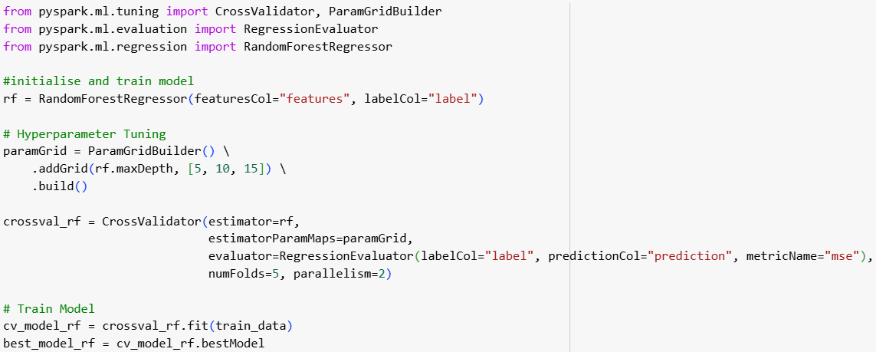
Random Forest Regressor
Task 2: Spark MLlib

Slide 43
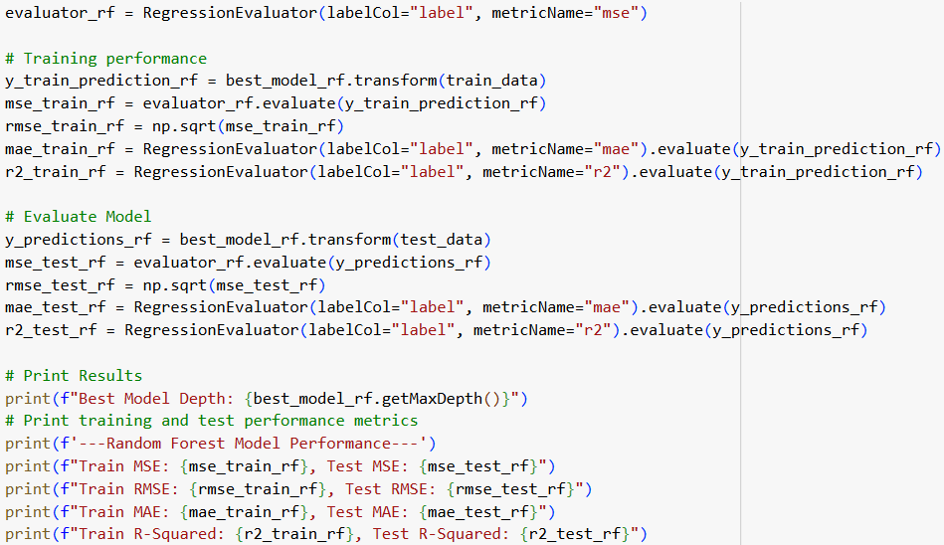
Random Forest Regressor
Best Model Depth: 15
 | Train Data | Test Data
Mean Squared Error | 19851427.091 | 19958283.961
Root Mean Squared Error | 4455.494 | 4467.470
Mean Absolute Error | 2716.019 | 2735.782
R-Squared | 0.96151 | 0.96108

Slide 44
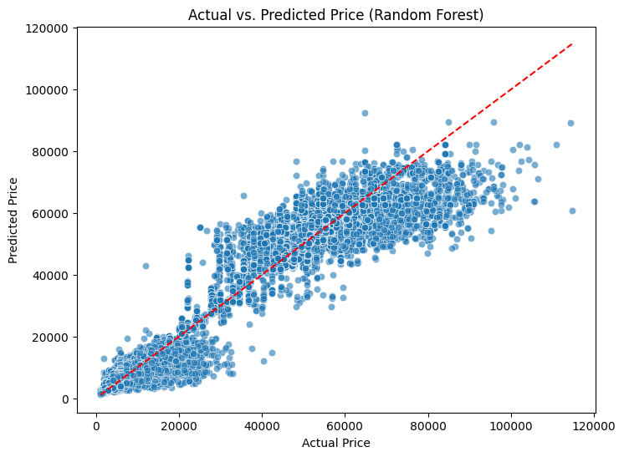
Random Forest Regressor
Able to capture trend reasonably well.
However, distinct horizontal clusters can be seen.
More errors made as prices increase.
Notes:
Model underestimates higher pricing flights but is able to predict low-mid price range well

Slide 45
Gradient Boosting

Slide 46
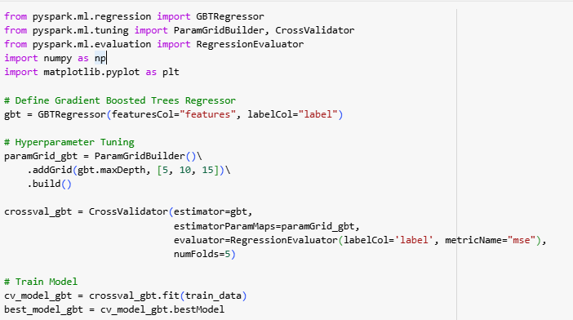
Gradient Boosting Regressor
Task 2: Spark MLlib

Slide 47
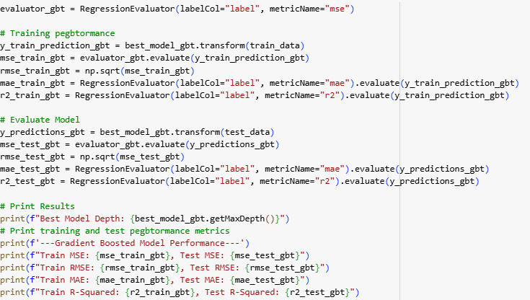
Gradient Boosting Regressor
Best Model Depth : 15
 | Train Data | Test Data
Mean Squared Error | 15955117.546 | 17358369.412
Root- Mean Squared Error | 3994.386 | 4166.338
Mean Absolute Error | 2334.699 | 2445.251
R-Squared | 0.96907 | 0.96615

Slide 48

Gradient Boosting Regressor (Actual vs. Predicted)
Captures overall trends well.
A fairly predictive accuracy.
However, struggles with higher price ranges with Higher Variance

Slide 49
Model Performance
Task 2: Spark MLlib
Model | MSE (Mean Squared Error) | RMSE (Root Mean Squared Error) | MAE (Mean Absolute Error) | R-Squared
Decision Tree | 17432124.374 | 4175.179 | 2441.642 | 0.96601
Random Forest | 19958283.961 | 4467.470 | 2735.782 | 0.96108
Gradient Boosted | 17358369.412 | 4166.338 | 2445.251 | 0.96615

Slide 50
Model Comparison
Scikit-Learn vs. Spark MLlib
Scikit-Learn
Spark MLlib
Model | MSE (Mean Squared Error) | RMSE (Root Mean Squared Error) | MAE (Mean Absolute Error) | R-Squared
Decision Tree | 8564914.485 | 2926.587 | 1196.994 | 0.98338
Random Forest | 7272233.184 | 2696.708 | 1096.053 | 0.98589
Gradient Boosted | 11136187.400 | 3337.093 | 1870.507 | 0.97840
Model | MSE (Mean Squared Error) | RMSE (Root Mean Squared Error) | MAE (Mean Absolute Error) | R-Squared
Decision Tree | 17432124.374 | 4175.179 | 2441.642 | 0.96601
Random Forest | 19958283.961 | 4467.470 | 2735.782 | 0.96108
Gradient Boosted | 17358369.412 | 4166.338 | 2445.251 | 0.96615

Slide 51
Model Comparison
Scikit-Learn vs. Spark MLlib
Scikit Learn | Spark MLlib
Tends to achieve higher accuracy on small to medium datasets | May be lower for small datasets due to distributed computing overhead
User-friendly, extensive documentation | Requires more setup, API is less intuitive
Optimized for single-machine performance | Scales well for large datasets but has overhead for small ones
Highly flexible, wide range of models | Limited customization, fewer algorithms
Notes:
"Ultimately, the choice between Scikit-Learn and Spark MLlib depends on the dataset size and computational requirements. If we are working with small to medium datasets, Scikit-Learn is a great choice. However, for large-scale applications, Spark MLlib is the better option."
"This project highlighted the importance of hyperparameter tuning, feature importance analysis, and understanding model limitations.”

Slide 52
The End

